Slide 1

The VQA Model and Train
Visual Question Answering
(VQA)
Supervisor Name:
郑锋
List of team members:
张一弛 11813226
杨英特 11812518

Slide 2
Introduction About our Group project
/ 01

Slide 3
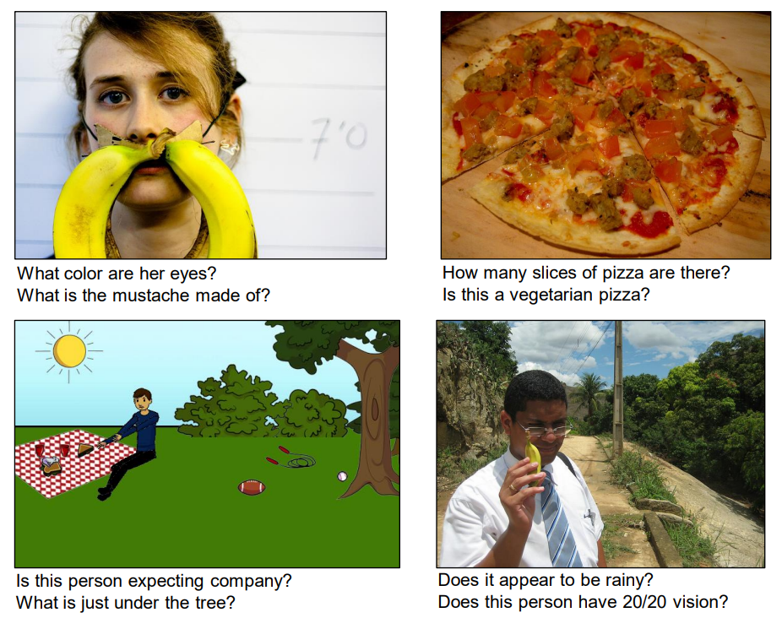
Introduction
VQA

Slide 4
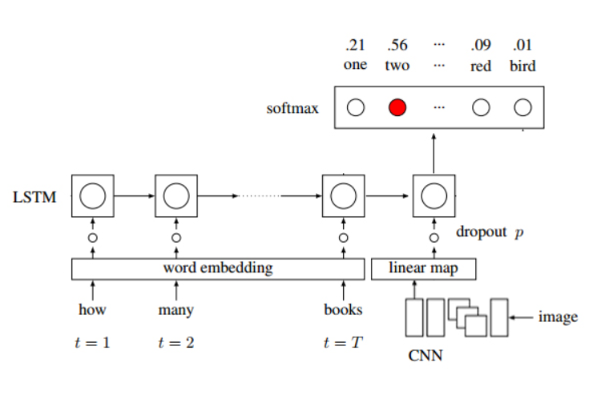
Introduction
Model of VQA

Slide 5
/ 02
Progress Have done and going to do

Slide 6
Our Progress
What we have done
Word segmentation
Word embedding
Image feature extraction
Model training

Slide 7
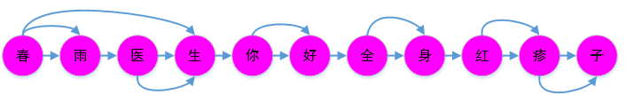
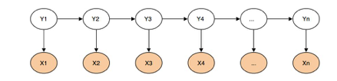
Our Progress – Word segmentation
Jieba
Word segmentation based on Thesaurus
HMM

Slide 8
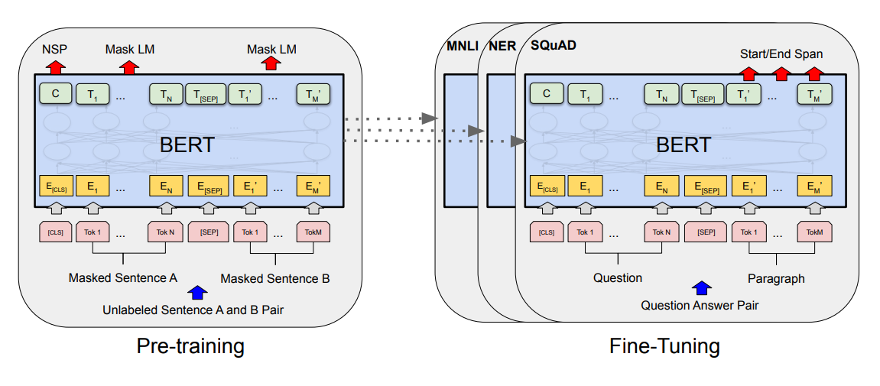
Our Progress – BERT

Slide 9
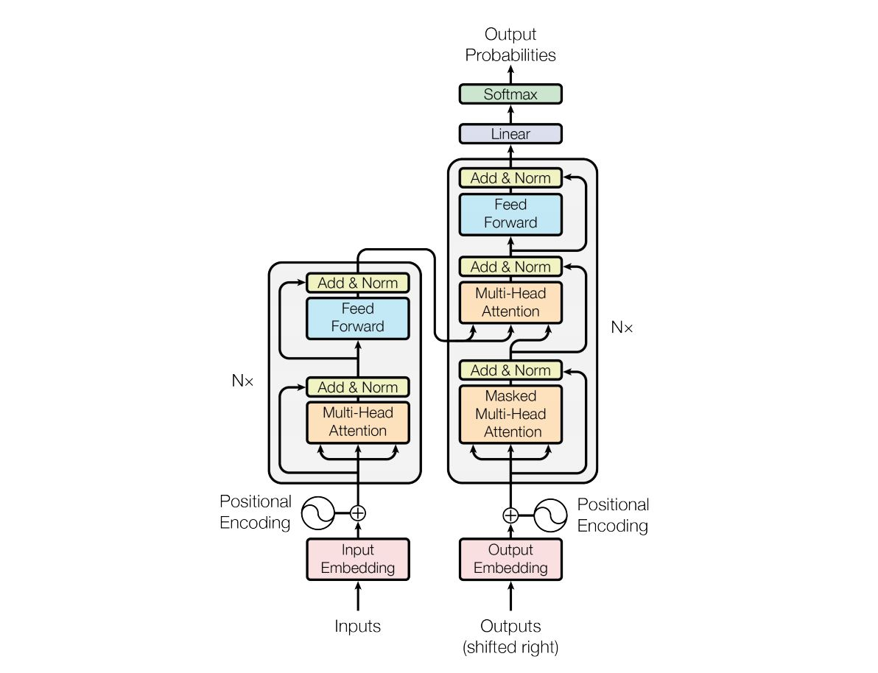
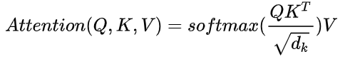
Our Progress – BERT
Transformer

Slide 10
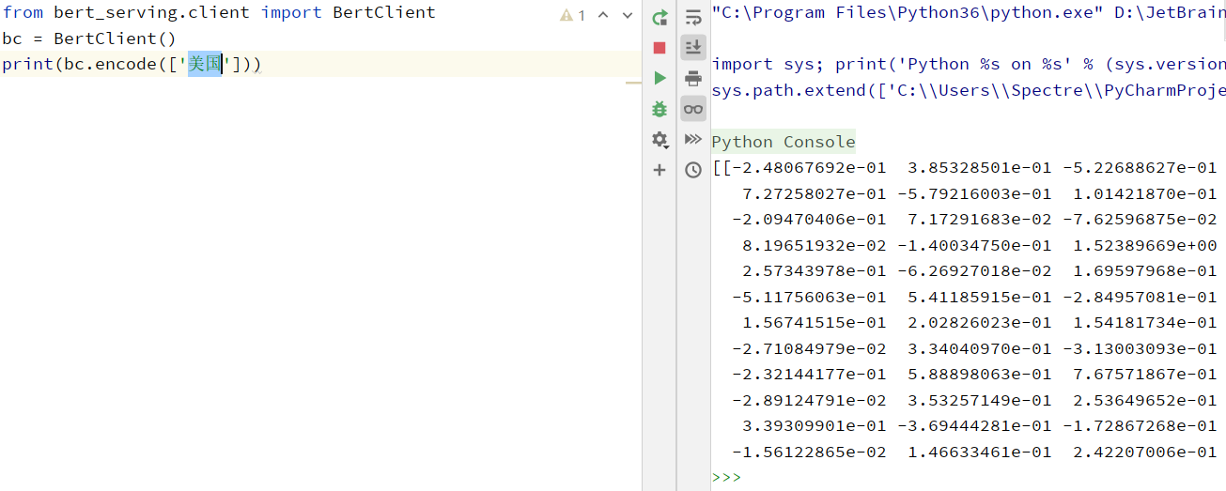
Our Progress – BERT

Slide 11
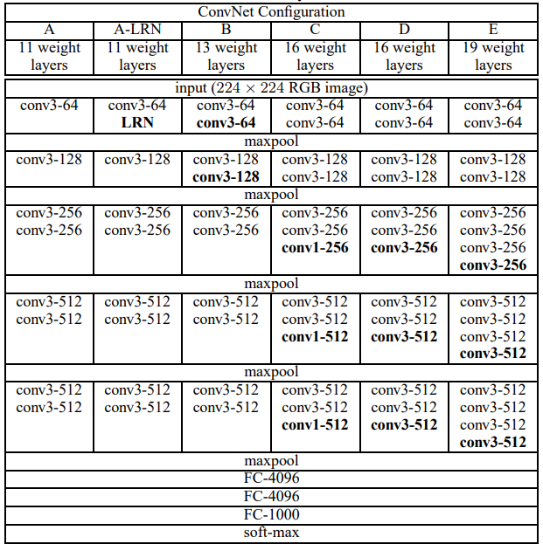
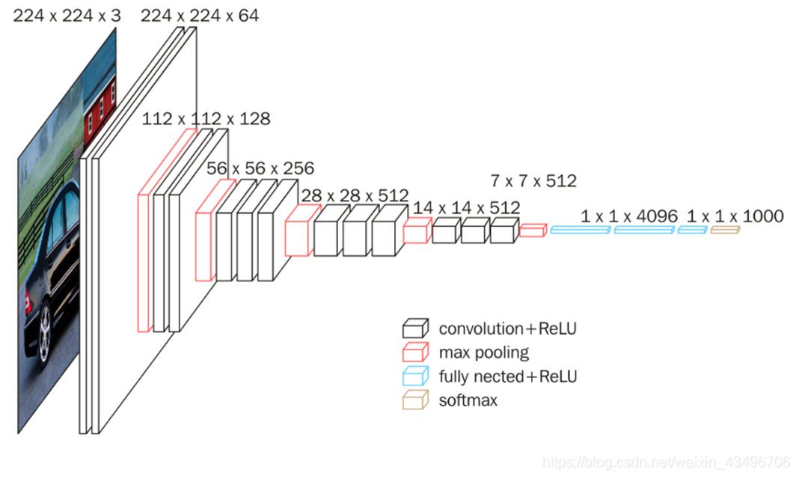
Our Progress – Image feature extraction
VGG16

Slide 12
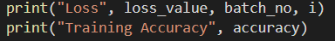
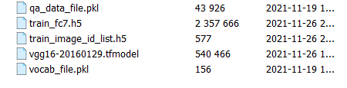
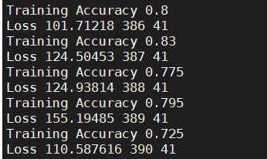
Our Progress – Model training
Processed data
Training

Slide 13
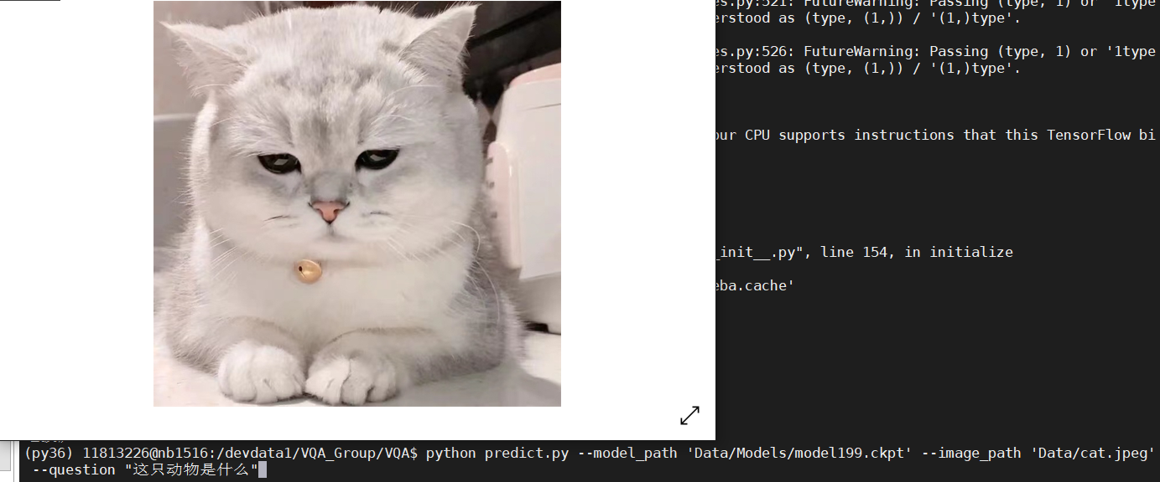
Our Progress – Model training

Slide 14
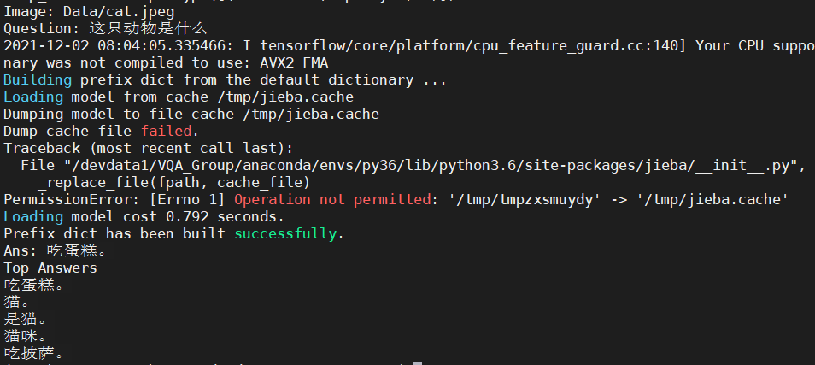
Our Progress – Model training

Slide 15
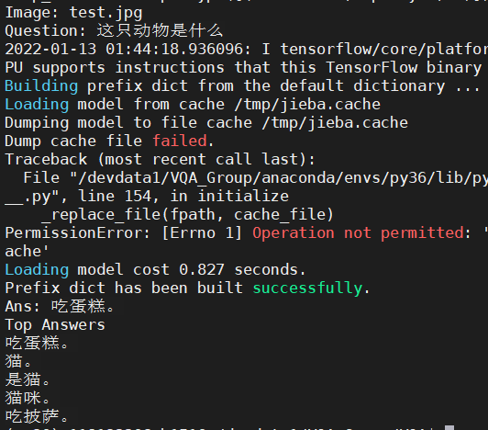
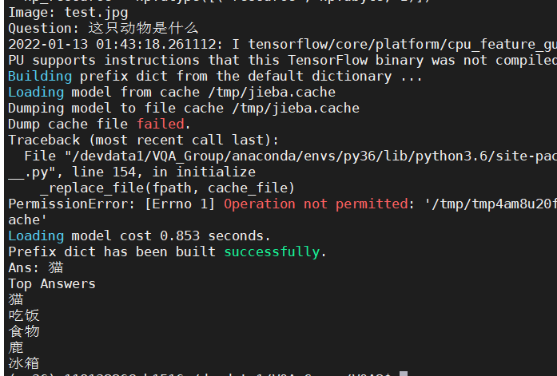
Our Progress – Evaluation and analysis

Slide 16
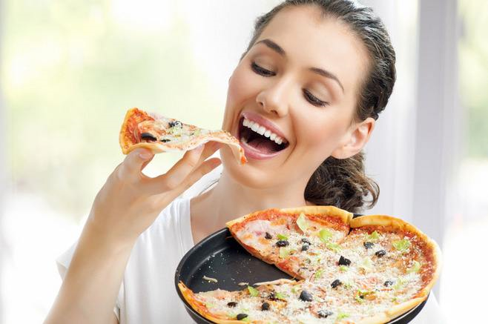
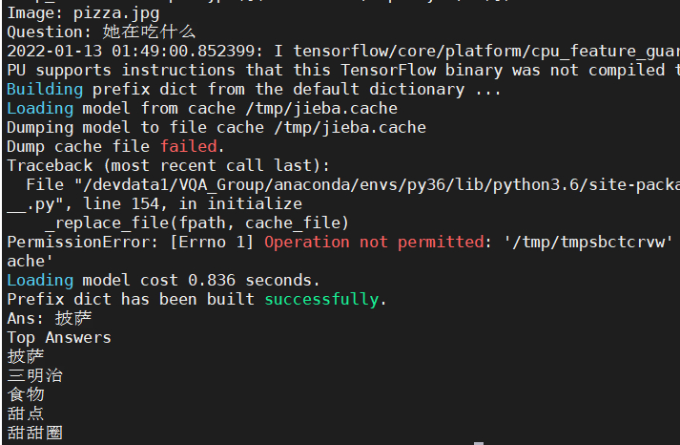
Our Progress – Evaluation and analysis

Slide 17

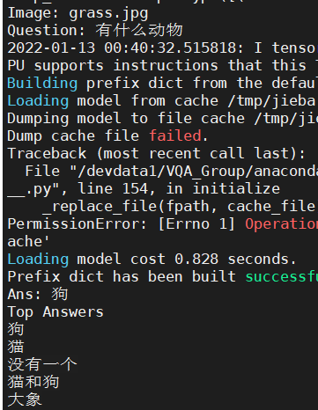
Our Progress – Evaluation and analysis

Slide 18
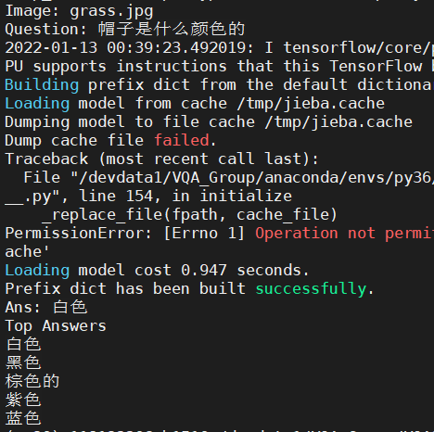
Our Progress – Evaluation and analysis

Slide 19
Reference
[1] Zhou, B. , Tian, Y. , Sukhbaatar, S. , Szlam, A. , & Fergus, R. . VQA: Visual Question Answering.
[2] Ren, M. , Kiros, R. , & Zemel, R. . (2015). Exploring models and data for image question answering. Litoral Revista De La Poesía Y El Pensamiento, 2953-2961.
[3] Simonyan, K. , & Zisserman, A. . (2014). Very deep convolutional networks for large-scale image recognition. Computer Science.
[4] YuanyuanQiu, HongzhengLi, ShenLi, YingdiJiang, RenfenHu, & LijiaoYang. (2018). Revisiting correlations between intrinsic and extrinsic evaluations of word embeddings.
[5] Zhongguo Li, Maosong Sun. Punctuation as Implicit Annotations for Chinese Word Segmentation. Computational Linguistics, vol. 35, no. 4, pp. 505-512, 2009.

Slide 20
Reference
[6] Vaswani, A. , Shazeer, N. , Parmar, N. , Uszkoreit, J. , Jones, L. , & Gomez, A. N. , et al. (2017). Attention is all you need. arXiv.
[7] Devlin, J. , Chang, M. W. , Lee, K. , & Toutanova, K. . (2018). Bert: pre-training of deep bidirectional transformers for language understanding.
[8] Zhang, Z. , Han, X. , Liu, Z. , Jiang, X. , Sun, M. , & Liu, Q. . (2019). ERNIE: Enhanced Language Representation with Informative Entities. Proceedings of the 57th Annual Meeting of the Association for Computational Linguistics.
[9] Sun, Y. , Wang, S. , Li, Y. , Feng, S. , & Wu, H. . (2019). Ernie: enhanced representation through knowledge integration.

Slide 21
Thanks
Supervisor Name:
郑锋
List of team members:
张一弛 11813226
杨英特 11812518

